Slide 1
BROKEWISE
All in one web application designed to revolutionize the way you manage your finances!

Slide 2
ABOUT BROKEWISE
In the era of intricate finances, BrokeWise emerges as your ultimate financial companion. It's a financial empowerment tool designed to simplify your money management experience. With BrokeWise, you can effortlessly track your expenses, set realistic financial goals, and gain real-time insights into your financial health.
Imagine having a virtual financial advisor at your fingertips, guiding you towards smarter spending, better savings, and effective debt reduction strategies.

Slide 3
Need for BrokeWise in Today's Financial Landscape
Complex Financial Landscape: As the financial landscape becomes more intricate, individuals often find it challenging to keep track of their income, expenses, and savings.
Rising Expenses and Debt: With the increasing cost of living and higher education expenses, many people struggle with managing debt effectively.
Financial Awareness: In an era of abundant options and spending opportunities, it's essential to cultivate financial awareness.
Goal-Oriented Approach: Setting and achieving financial goals is a priority for individuals and families.
Holistic Financial Health: Financial well-being encompasses more than just tracking expenses. BrokeWise offers a holistic approach by integrating budgeting, savings, debt management, and goal planning in one platform.

Slide 4
KEY FEATURES
📊 Real-Time Financial Insights: Stay on top of your financial health with up-to-the-minute insights into your income, expenses, and savings. BrokeWise provides you with a clear snapshot of where your money is going.
Categorization and Analysis: Each expense is automatically categorized into defined categories (e.g., groceries, entertainment, utilities) based on the type of transaction. This categorization provides users with an instant overview of where their money is going, helping them identify patterns in their spending behaviour.
Visualize Spending Patterns: The application generates visual charts and reports that display spending trends over time. These graphical representations make it easy for users to visualize their financial data, track changes, and gain deeper insights into their spending patterns.

Slide 5
TECH STACK
HTML
CSS
JAVASCRIPT
BOOTSTRAP
DSA IN C++

Slide 6
TARGET AUDIENCE
Young Professionals and Millennials
Families
Students and Recent Graduates
Freelancers and Gig Economy Workers
Small Business Owners
Individuals with Debt

Slide 7
PROGRESS REPORT
Created Basic Layout for BrokeWise using HTML and CSS.
Created Logo for BrokeWise using icons from Bootstrap.
Added Navigation Tab which include About, Key Features and Benefits of BrokeWise which is styled using Bootstrap Framework.
Used chart.js which is a JavaScript Library used for making basic HTML charts
Created expenses and income chart using chart.js
Created Total Income and Expense Calculator functions using Javascript

Slide 8
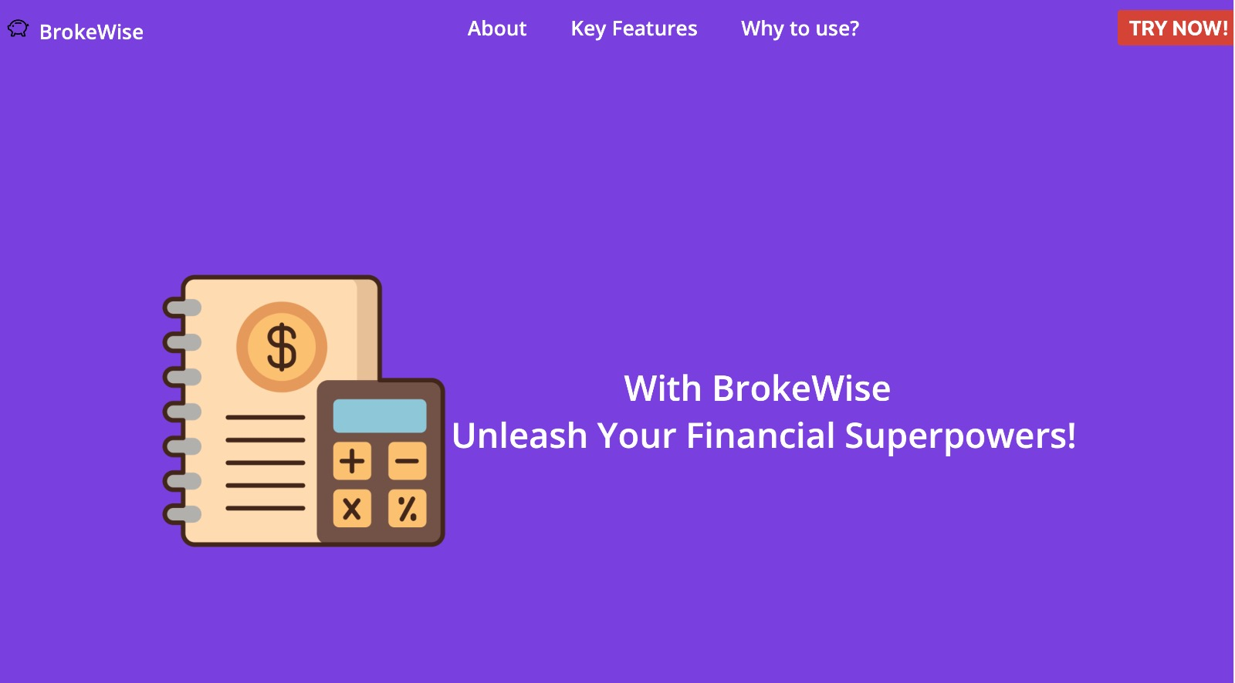
SCREENSHOTS/IMAGES

Slide 9
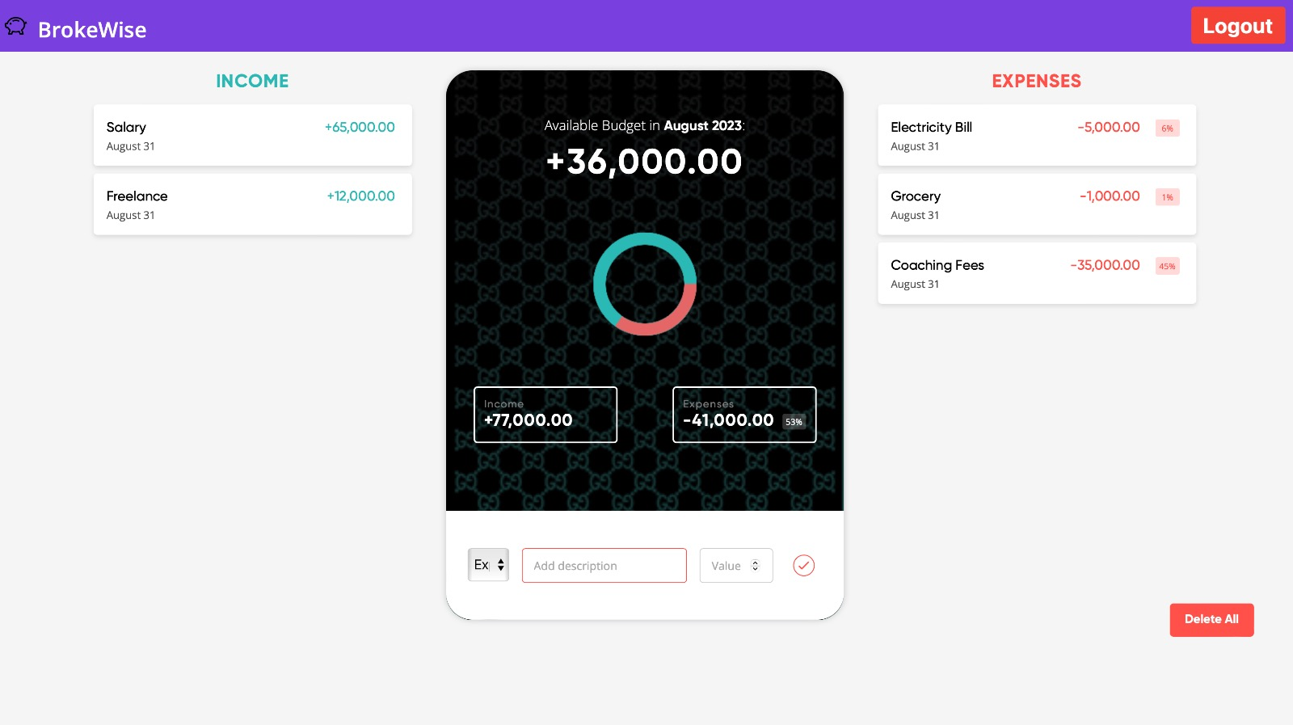
SCREENSHOTS/IMAGES

Slide 10
THANK YOU!

